Slide 1
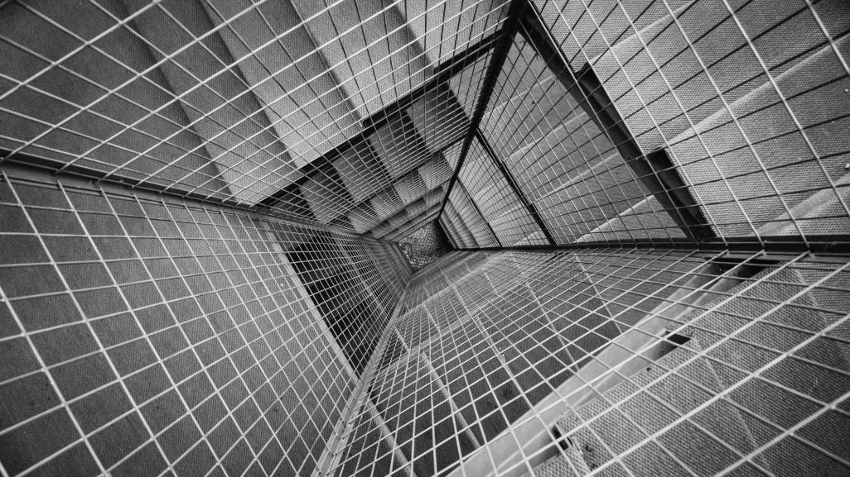
LIVE SURVEILLANCE THROUGH MOTION DETECTION
NANDHINI.M BEULAH.S
21MDT1017 21MDT1044
Under the guidance of : Dr. JEETASHREE APARAJEETA
Assistant professor(senior)
School of Electronics Engineering
Vellore Institute of Technology
Chennai, India

Slide 2
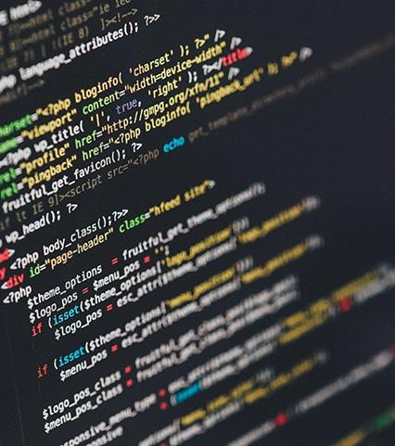
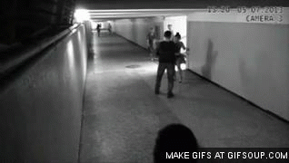
IT can detect any movement by tracking the changes in each frame of a video
PROBLEM STATEMENT

Slide 3
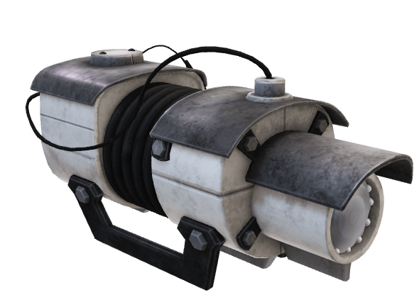
1. Using a camera to capture events (e.g. human activity) in public places reduces Crime Rates. 2. Detection of unauthorized access in the immediate vicinity.
MOTIVATION

Slide 4
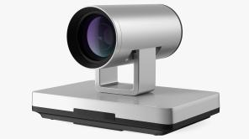
LITERATURE SURVEY
The model has the ability to detect motion along with maintaining the record of time duration during which the motion in background is detected.

Slide 5
MODEL
Original Image
Gray Image
Dilation
Contour Detection
Detection of object with motion
Thresholding
Gaussian Filter
Frame subtraction
GAUSSIAN FILTER : A Gaussian filter is a linear filter. It is used for reducing noise.
CONTOUR DETECTION : It detects borders of objects and detects them easily.
DILATION : It is a technique where we expand the image

Slide 6


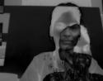


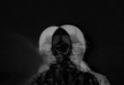
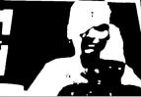
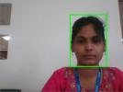


results
Taken from a bright indoor environment
Taken from a dim indoor environment
Frame Difference
Frame Difference
Original Image
Gray Image
Original Image
Gray image
Detected object with motion
Detected object with motion
Thresholding
Thresholding

Slide 7
CONCLUSION
The proposed model can effectively detect an object in a bright and dim indoor environment or outdoor environment with fixed lighting.

Slide 8

REFERENCE
[1] R. Kelley, M. Nicolescu, A. Tavakkoli, C. King, and G. Bebis, "Understanding human intentions via Hidden Markov Models in autonomous mobile robots," in 3rd ACM/IEEE International Conference on Human-Robot Interaction (HRI), 2008, pp. 367-374
[2] L. Snidaro, C. Micheloni, and C. Chiavedale, "Video security for ambient intelligence," IEEE Transactions on Systems, Man and Cybernetics, Part A: Systems and Humans, vol. 35, pp. 133-144, 2005
[3] D. F. Glas, T. Miyashita, H. Ishiguro, and N. Hagita, "Laser tracking of human body motion using adaptive shape modeling," in Intelligent Robots and Systems, 2007. IROS 2007. IEEE/RSJ International Conference on, 2007, pp. 602-608.
[4] S. Parveen and J. Shah, "A Motion Detection System in Python and Opencv," 2021 Third International Conference on Intelligent Communication Technologies and Virtual Mobile Networks (ICICV), 2021, pp. 1378-1382, doi: 10.1109/ICICV50876.2021.9388404.
[5] L. Spinello and K. O. Arras, "People detection in RGB-D data," in Intelligent Robots and Systems (IROS), 2011 IEEE/RSJ International Conference on, 2011, pp. 3838-3843.
[6] B. Choi, C. Mericli, J. Biswas, and M. Veloso, "Fast human detection for indoor mobile robots using depth images," in Robotics and Automation (ICRA), 2013 IEEE International Conference on, 2013.
[7] A. Bevilacqua, L. Di Stefano, and P. Azzari, "People Tracking Using a Time-of-Flight Depth Sensor," in IEEE International Conference on Video and Signal Based Surveillance, 2006, pp. 89-89.
[8] C. Stauffer and W. E. L. Grimson, "Adaptive background mixture models for real-time tracking," in IEEE Computer Society Conference on Computer Vision and Pattern Recognition, 1999, p. 252 Vol. 2.
[9] T. Tseng, A. Liu, P. Hsiao, C. Huang and L. Fu, "Real-time people detection and tracking for indoor surveillance using multiple top-view depth cameras," 2014 IEEE/RSJ International Conference on Intelligent Robots and Systems, 2014, pp. 4077-4082, doi: 10.1109/IROS.2014.6943136.
[10] Julien Richefeu, Antoine Manzanera, "A Newhybrid Differential Filter for Motion Detection", Ecole Nationale Superieure de Techniques Avancees, Jan 2005.

Slide 9
[11]R. Cucchiara, C. Grana, M. Piccardi, and A. Prati, "Detecting objects, shadows and ghosts in video streams by exploiting color and motion information," in 11th International Conference on Image Analysis and Processing, 2001, pp. 360-365
[12] A. M. Thomas, A. Ashraf, L. Lal, M. J. Mathew and M. J. Jayashree, "Security enhancement using motion detection," 2011 International Conference on Signal Processing, Communication, Computing and Networking Technologies, 2011.
[13] R. Radke, S. Andra, O. Al-Kofahi and B. Roysam, "Image Change Detection Algorithms: A Systematic Survey", IEEE Transactions on Image Processing, vol. 14, no. 3, pp. 294-307, March 2005
[14] .Davide A. Migliore," A Revaluation of Frame Difference in Fast and Robust Motion Detection", AIRLab, Politecnico di Milano, Italy, May 2006.
[15] S. Roy, "Motion Detection Using Image Processing," 2019 Global Conference for Advancement in Technology (GCAT)

